Slide 1
Trusts Law
Week 12: Fiduciary duties and associated remedies
Dr Johanna Jacques

Slide 2
Looking ahead…
Teaching week* | Date | Topic | Lecturer
Week 11 (26) | 13 January | Charitable trusts | MP
Week 12 (27) | 20 January | Fiduciary duties and associated remedies | JJ
Week 13 (28) | 27 January | Non-fiduciary duties | JJ
Week 14 (29) | 3 February | Remedies for breach of non-fiduciary duties | JJ
Week 15 (30) | 10 February | Tracing (I) | JJ
Week 16 (31) | 17 February | Tracing (II) | JJ
Week 17 (32) | 24 February | Dishonest assistance | JJ
Week 18 (33) | 3 March | Knowing receipt | JJ
Week 19 (34) | 10 March | The variation of trusts | JJ
Week 20 (35) | 17 March | The trust in an international context | MP

Slide 3
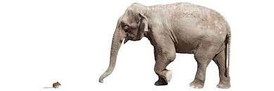
So, why are breaches and remedies important?
Trusts involve the separation of substantive ownership from control.
Trustees often have powers to determine who gets what and when (e.g., in discretionary trust arrangements).
There is little ability for beneficiaries or settlors to determine the actions of trustees.
There is little visibility for beneficiaries as to what happens to the trust property during the duration of a trust.
Means and opportunity can sometimes create motivation.
Trusts often involve power differentials
that necessitate the legal protection
of the beneficiaries’ rights.

Slide 4
When things with a trust go wrong
Once a beneficiary realises that something has gone wrong with the trust, they need to determine:
STEP 1 - What duty has been breached?
STEP 2 - Who may be liable?
STEP 3 - What remedies are available?
STEP 4 - What property or part thereof may be recovered?

Slide 5
Components of the law
DUTY | WHO | REMEDIES | PROPERTY
Fiduciary Common law | Trustee | Personal Various | Tracing Common law Equity
Non-fiduciary Trust deed Common law Statute | 3rd Party Assistant Recipient | Proprietary Various
Unfortunately, there is much judicial and academic disagreement on terms, analyses, effects…

Slide 6
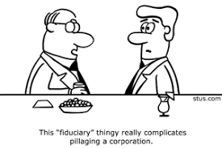
This week
This week:
We will begin our exploration of trustee duties by looking at their duties as fiduciaries.
We will also consider the remedies available to beneficiaries for breach of fiduciary duties.

Slide 7
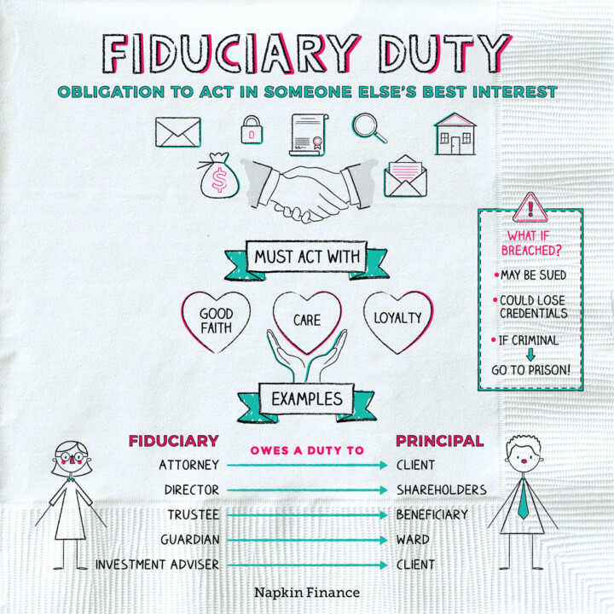

Slide 8

The essence of fiduciary duty
“The distinguishing obligation of a fiduciary is the obligation of loyalty. The principal is entitled to the single-minded loyalty of his fiduciary” (Lord Millet in Bristol and West Building Society v. Mothew [1998] 1 Ch 1).
But is loyalty really required?
The focus should be on the exercising judgment and the ‘orientation’ of that judgment (Penner).
Fiduciary duty is protective/prophylactic (Conaglen).

Slide 9


The rules
The ‘no conflict of interests’ rule
The ‘no unauthorised profits’ rule
Are these really two distinct rules?

Slide 10
The ‘no conflict of interests’ rule
“It is an inflexible rule of a Court of Equity that a person in a fiduciary position ... is not, unless otherwise expressly provided ... allowed to put himself in a position where his interest and duty conflict.”
Lord Herschell in Bray v Ford [1896] AC 44
The rule is said to be inflexible, and is associated with strict liability
It serves to guarantee the fiduciary’s ‘undivided loyalty’ and to deter wrongdoing on their part
Two sub-rules, the rules on self-dealing and fair-dealing

Slide 11
The prohibition of self-dealing (with some exceptions)
3rd party
No*
Trustee
Trust property
Yes
Beneficiary
* Unless the sale is authorised by the trust instrument, all beneficiaries have approved it under full disclosure or the court has approved it.

Slide 12
The fair-dealing rule
3rd party
Trustee
Possible*
Trust property
Yes
Beneficiary
* Trustee needs to be able to show that the transaction was fair and honest.

Slide 13
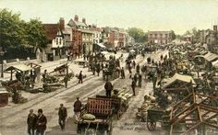
The ‘no unauthorised profit’ rule (I)
“This may seem harsh that the trustee is the only person of all mankind who might not have the lease; but it is very proper that the rule should be strictly pursued and not in the least relaxed.”
Lord King in Keech v Sandford (1726) Sel Cas Ch 61
“If a person in a fiduciary relationship makes a secret profit out of the relationship, the court will not inquire whether the other person . . . has lost a profit which otherwise he would have got. The fact is in itself a fundamental breach of the fiduciary relationship.”
Lord Wright in Regal (Hastings) Ltd v Gulliver [1967] 2 AC 134

Slide 14
The ‘no unauthorised profit’ rule (II)
Boardman v Phipps [1967] 2 AC 46
T’s
Boardman, solicitor (claimant)
Agency, advice
COMPANY
Trust owns 27% of
B’s; including John Phipps (respondent) and Tom Phipps
Boardman and Tom Phipps purchase remaining shares

Slide 15

Defences
Fully informed consent of the principal
Authorisation in the trust instrument
Authorisation in statute
Conflict inherent in trust

Slide 16

Remedies (I)
Self-dealing: Transaction voidable at the option of the beneficiary.
Fair-dealing: Transaction voidable if the trustee cannot show fairness.
Unauthorised profits: Fiduciary has to account for profits (personal or proprietary), but note special treatment of bribes and secret commissions:
  Attorney General for Hong Kong v Reid [1994] 1 AC 324
  FHR European Ventures LLP v Cedar Capital Partners LLC [2015] AC 250

Slide 17

Remedies (II)
Unauthorised profits - Fiduciaries who are Directors of companies: Can companies recover unauthorised profits from their Directors if the Directors’ criminal acts would usually be attributed to the company? See Crown Prosecution Service v Aquila Advisory Ltd [2021] UKSC 49.

Slide 18
Recap
Most trustees are fiduciaries, and in this capacity are subject to fiduciary duties.
Fiduciary duties can be divided into two main rules: The rule to avoid conflicts of interests and the rule not to make unauthorised profits.
The liability of fiduciaries is usually personal, but where trust property is concerned, it is proprietary.
There is considerable debate as to how to treat bribes and secret commissions, and how the fiduciary-principal relation should be construed in the case of Directors and companies.

Slide 19
Revision 1: Certainty of subject matter: Distributional certainty
'My houses to be held on trust, with my trustee to distribute them amongst my children when all have reached majority.’
Fine, as discretionary trust.
'Daughter A to choose one house, the other house on trust for daughter B' (Boyce v Boyce).
Trust for daughter B is fixed trust, but not clear which house is to be held for her and the specified resolution mechanism is no longer available. Fails.
‘One house to each of my nephews and nieces and one to N. H. One to F. K. One to my sister. One to my brother' (Re Knapton).
If a trust, this would be fixed. Ostensibly fails for uncertainty, but this can be cured by letting the beneficiaries chose in a certain order + resolution mechanism for disagreement.

Slide 20
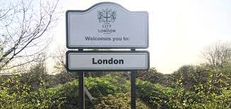
Revision 2: Certainty of objects: Administrative unworkability
What you need to know:
Applies only to discretionary trusts, not fixed trusts or powers of appointment.
Wilberforce LJ in McPhail v Doulton: Class conceptually certain, but "'so hopelessly wide as not to form 'anything like a class.'"
Uncertain basis: sheer number of people, practical difficulty, connection between settlor and class, size of fund compared to class, execution of trust by court?
Applied in R v District Auditor ex p West Yorkshire Metropolitan County Council.

Slide 21
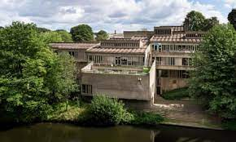
Activity
You have learned about charitable trusts, and as a student, you will be aware of the issues related to university administration, such as high executive remuneration and excessive focus on financial aspects of university ‘business.’ Today, you have also started to learn about the fiduciary duties of trustees. Why not put all these together? The following article provides some interesting insights on universities’ obligations as charities:
Synge M (2021) ‘Regulation of Universities as Charities: One Step Forward, Two Steps Back’ 41 Legal Studies 214 (available via the library’s Discover portal).

